Slide 1

Turbocharge your statistics lessons using R!
Dr Tim Paulden
CPD course (Mathematics Teachers' Network),
(Innovation & Development Manager, ATASS Sports)
Exeter Mathematics School, 2 & 23 June 2015

Slide 2
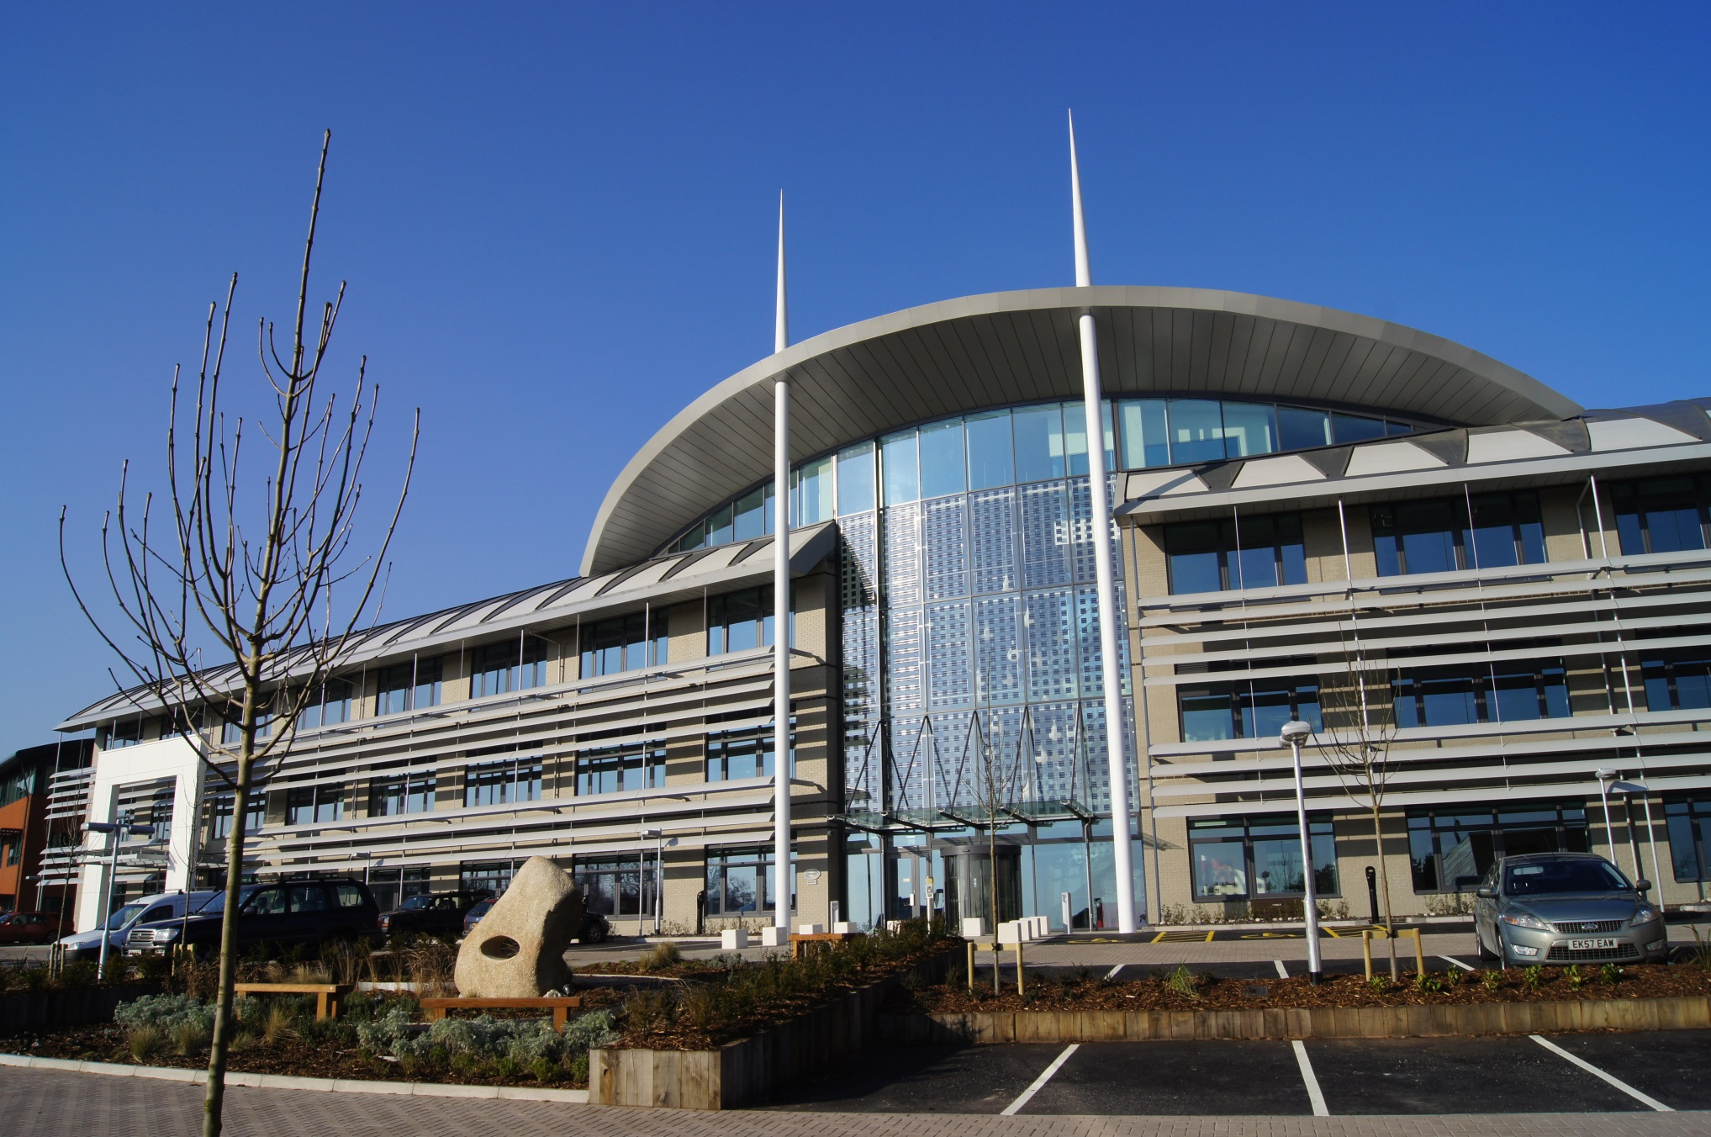

Slide 3


Slide 4
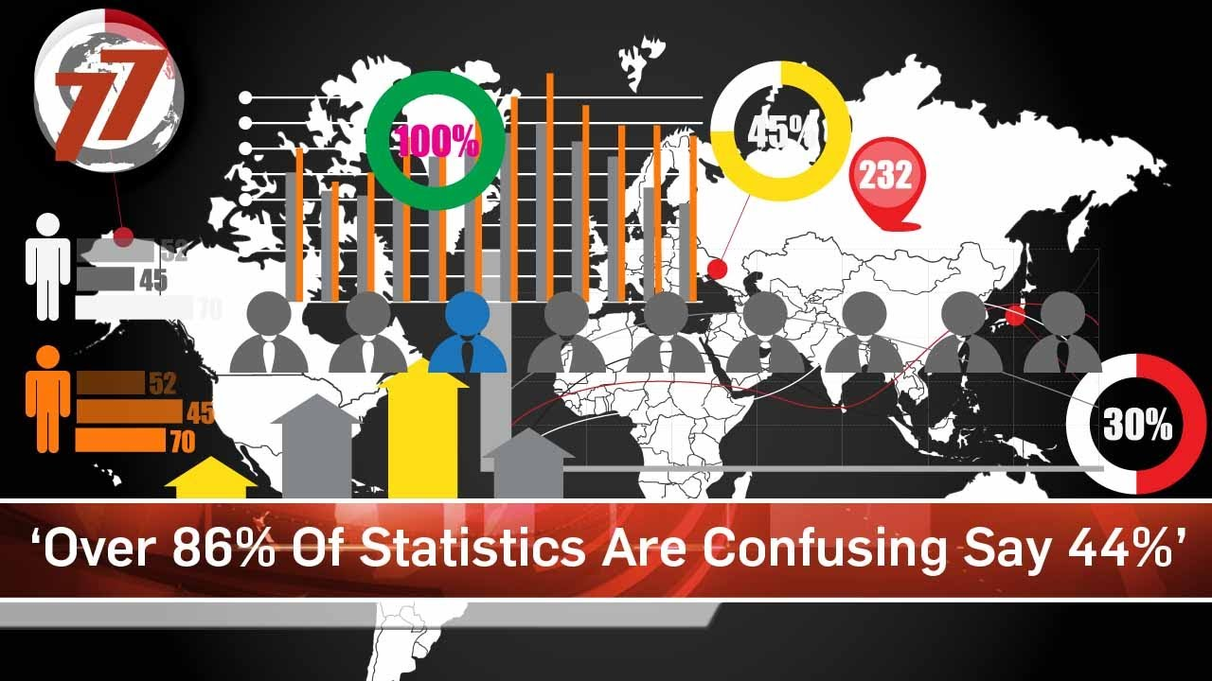

Slide 5


Slide 6
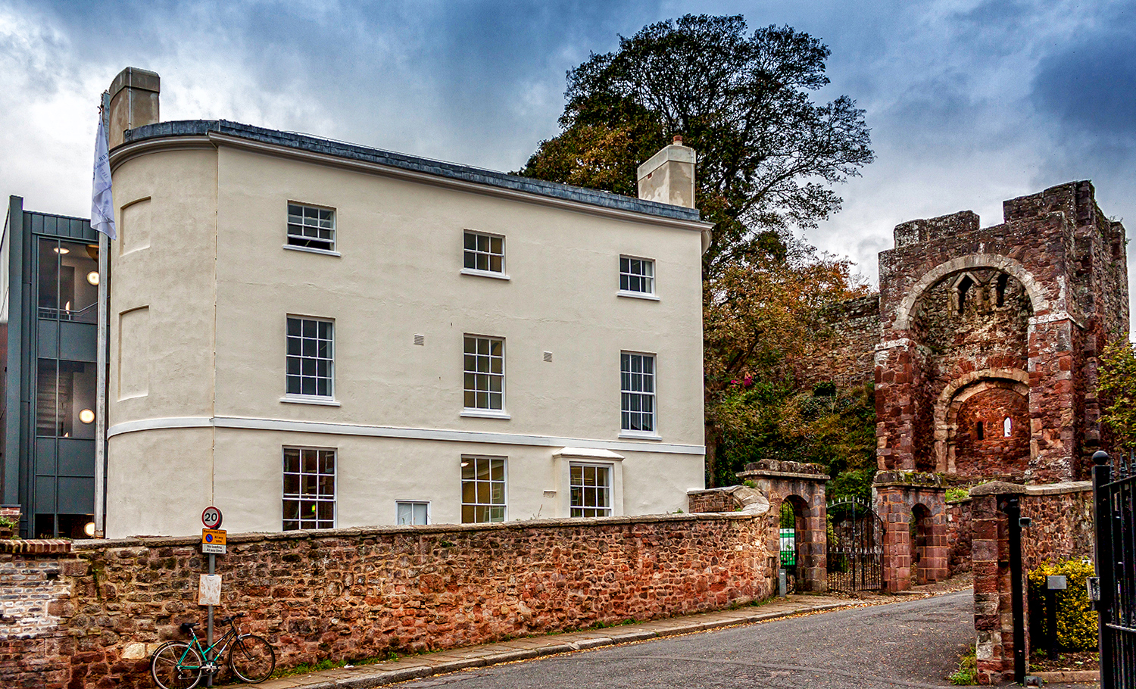

Slide 7
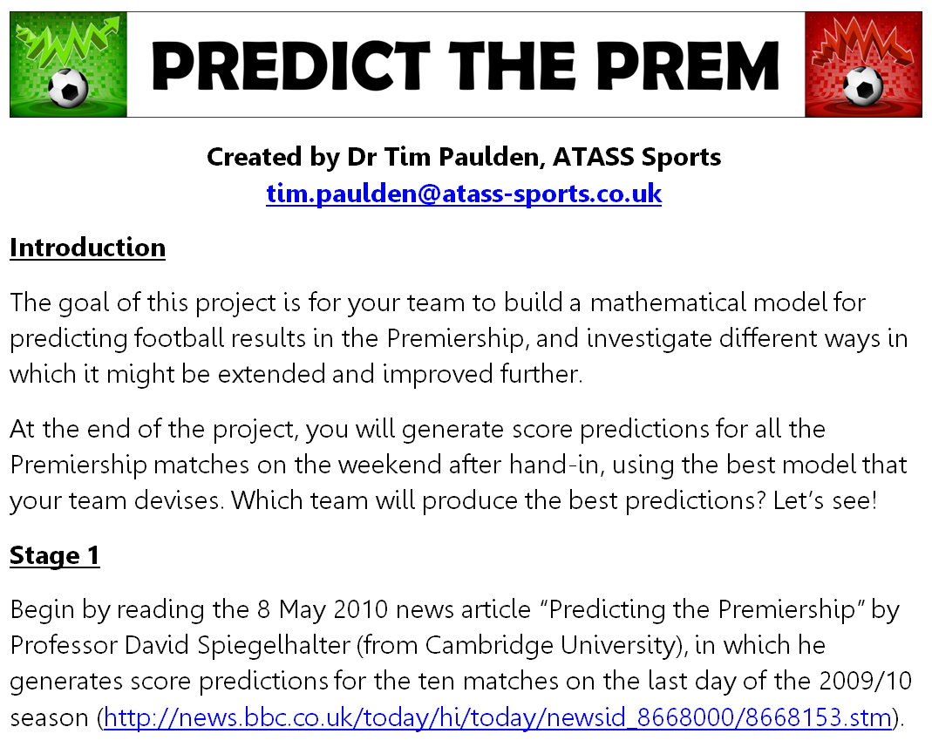

Slide 8
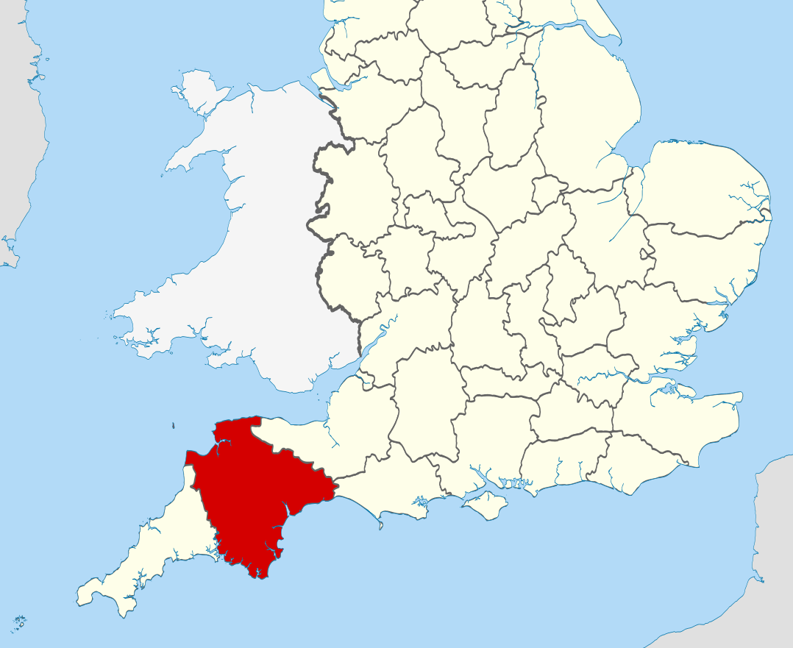

Slide 9
Why R?

Slide 10


Slide 11
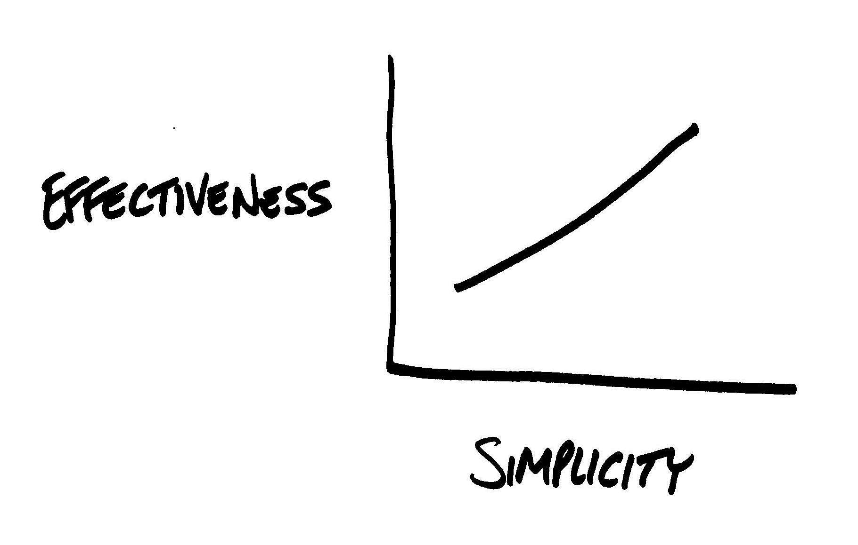

Slide 12


Slide 13
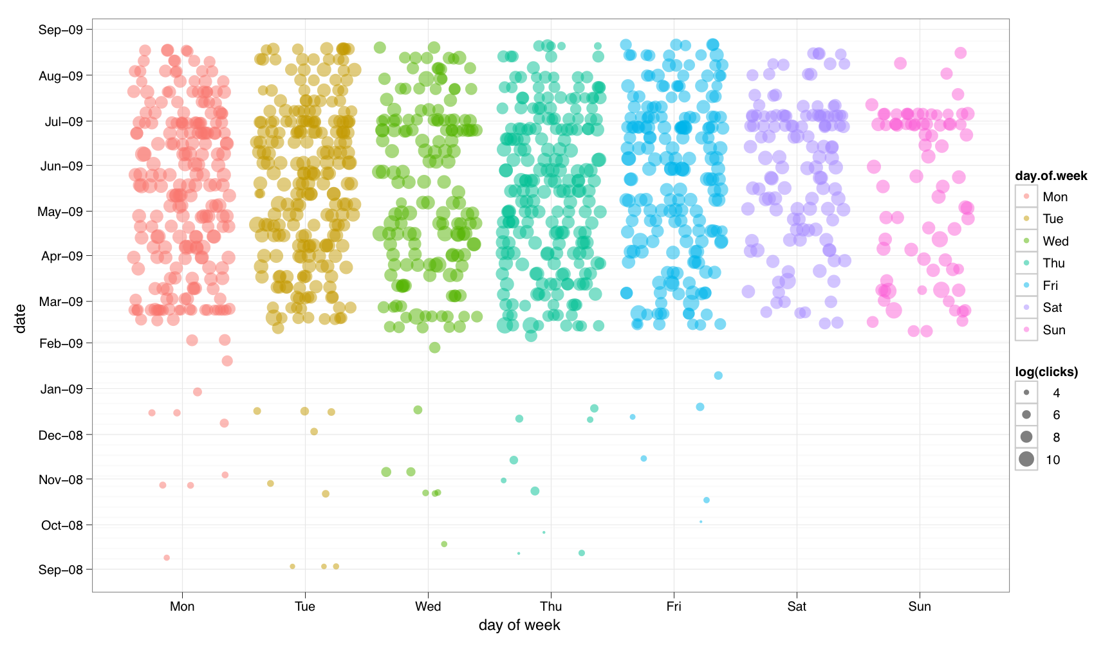

Slide 14
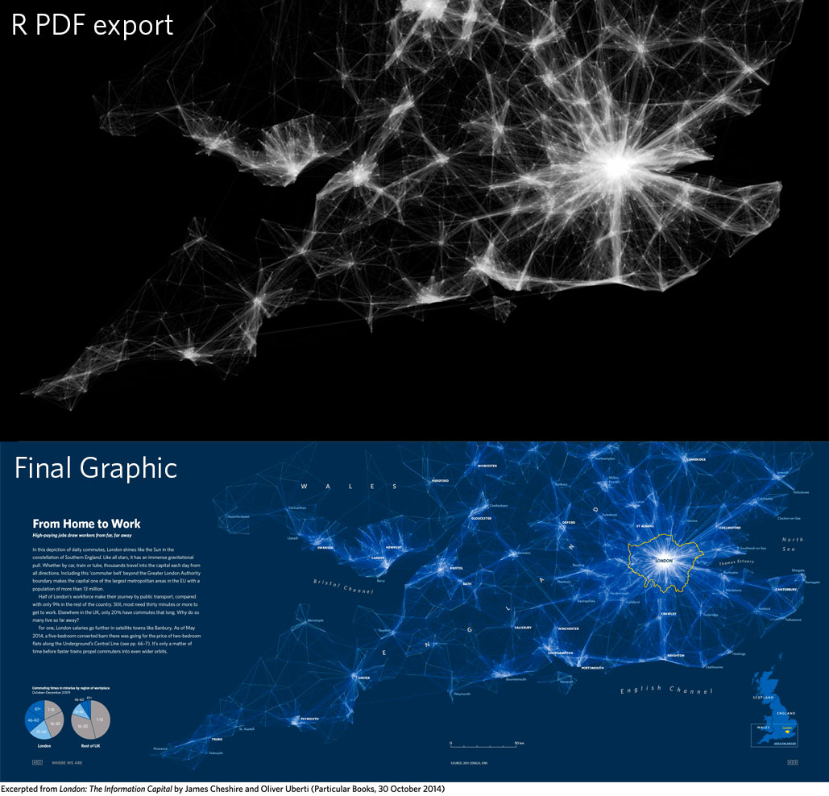

Slide 15
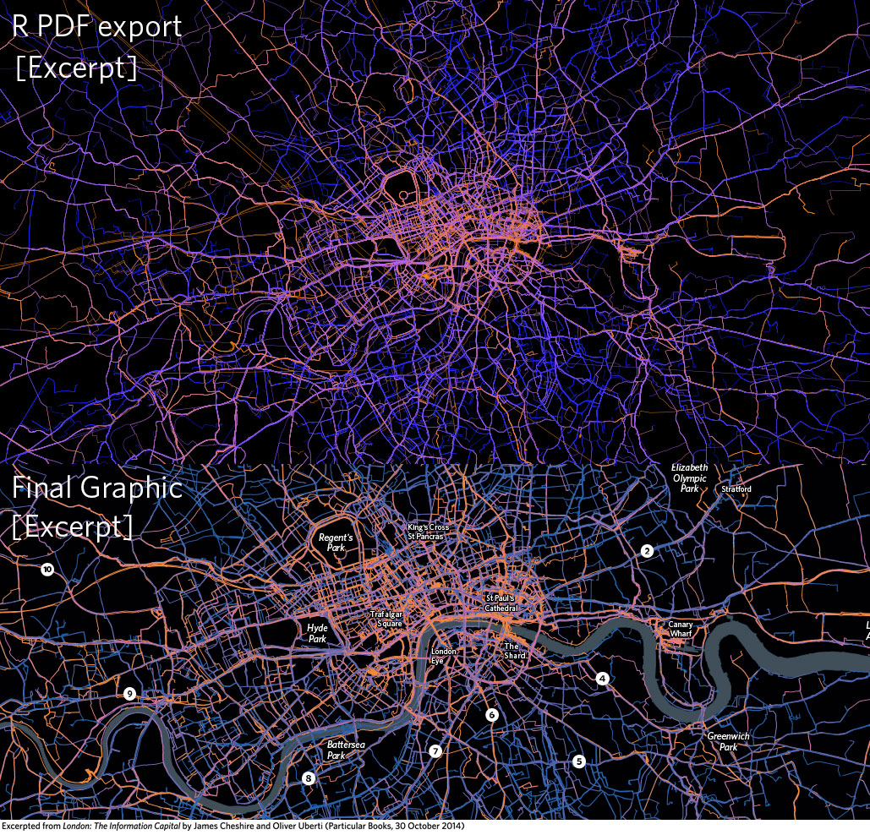

Slide 16
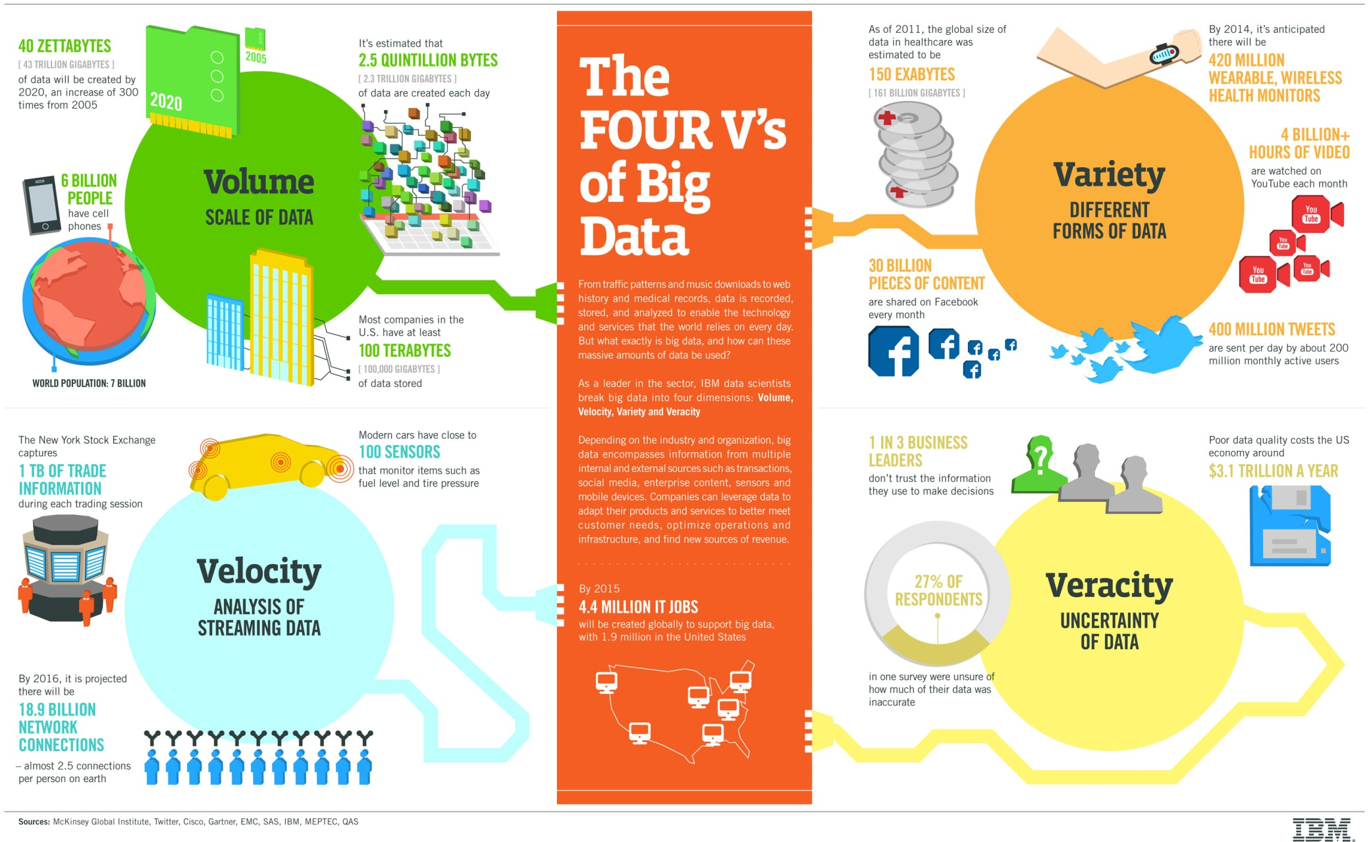

Slide 17


Slide 18
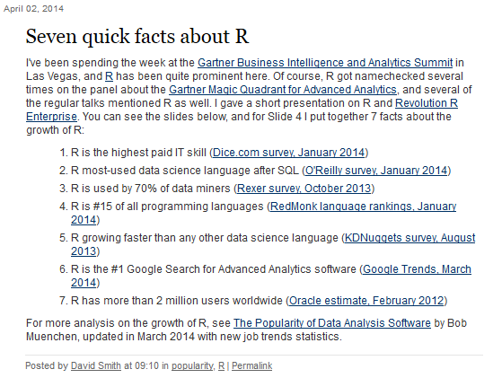

Slide 19
The basics of R

Slide 20
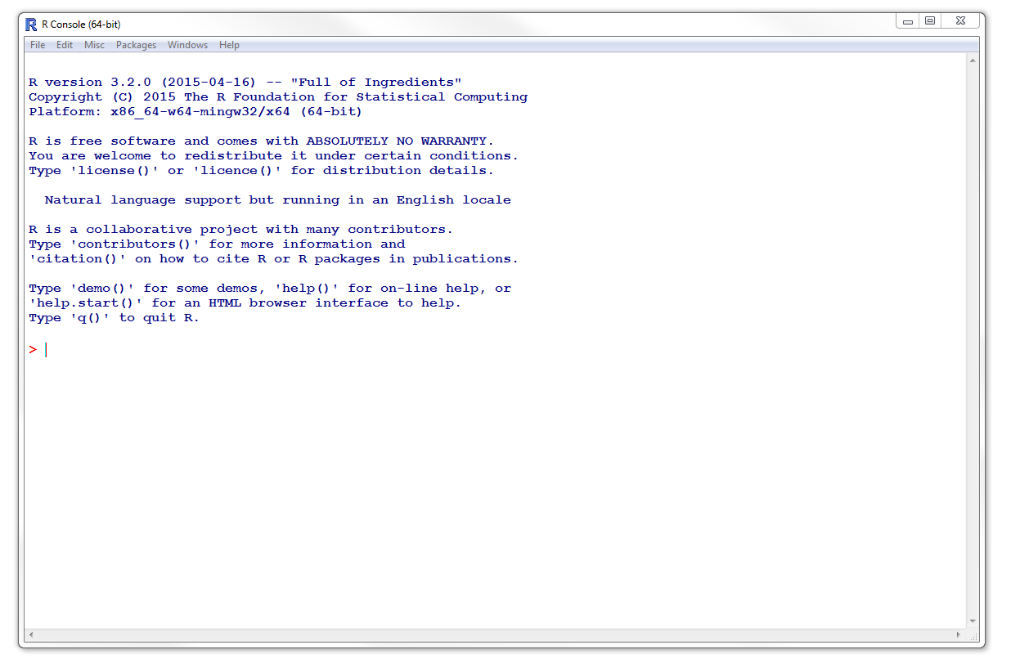

Slide 21
Using R like a calculator
Start up "RGui" (a.k.a. the "R Console")
Type the following into the white window:
1234 + 4567
[1] 5801
What do you think the "[1]" means?
How would you multiply 1234 and 4567?

Slide 22
Using R like a calculator
Spaces within commands are ignored:
1234+4567
[1] 5801
Use the up and down arrows to scroll through previously entered commands

Slide 23
Using R like a calculator
Of course, R can also work with decimals:
22/7
[1] 3.142857
22/7 - pi
[1] 0.001264489
By default, R shows you the answer to a small number of digits (7), but internally it stores numbers with much greater precision

Slide 24
Using R like a calculator
The power symbol in R is ^ as shown below:
3^4
[1] 81
Quick activity: Spend 20 seconds estimating the value of 9^6, then check using R

Slide 25
Using R like a calculator
Of course, R follows BIDMAS:
10+20/5
[1] 14
20/5^2
[1] 0.8
(20/5)^2
[1] 16

Slide 26
Variables
You can store the answer to a calculation in a variable (using whatever name you like):
myvar = 7*9
To see the contents of a variable, simply type its name:
myvar
[1] 63

Slide 27
Variables
And you can do any sort of operations you want on myvar – try it!
myvar/10
myvar^3
You can call variables whatever you want, though it usually helps to use short names

Slide 28
Introducing vectors
Enter the following command, which gives the whole numbers from 1001 to 1020 inclusive:
1001:1020
A list of numbers like this is known as a vector
It might be useful to quickly draw an analogy between an R vector and a column of numbers in Excel…

Slide 29
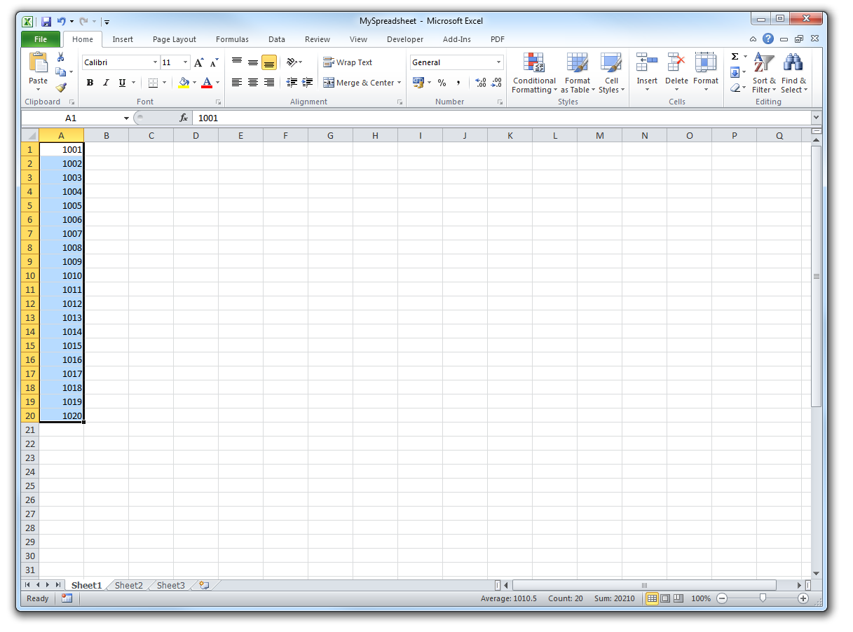
Introducing vectors

Slide 30
Introducing vectors
Now generate the numbers from 1001 to 2000 inclusive:
1001:2000
The square brackets shown on the left of the resulting R output simply indicate the position in the vector (where the first position is 1, the second position is 2, and so on)

Slide 31
Introducing vectors
The code below creates a vector called "myvec" containing the numbers from 11 to 70, and then displays the 17th number:
myvec = 11:70
myvec[17]
[1] 27
Quickly try a similar example for yourself

Slide 32
The combine command – "c"
Another easy way to create a vector is using the "c" function (which stands for "combine"):
mynum = c(1.6, -5, -2, 0, 8.6, -5)
As shown above, the numbers in a vector can be anything you want – including decimals, negatives, and zero – and can include repeats

Slide 33
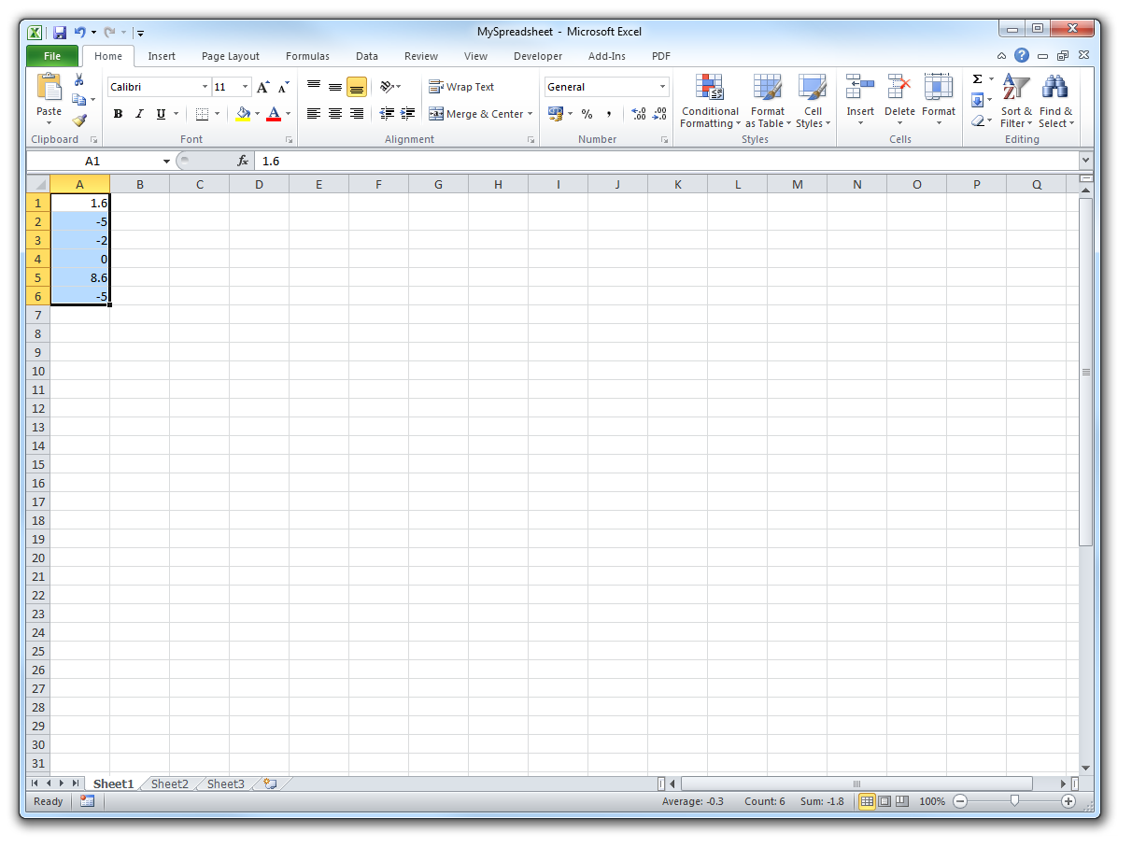
The combine command – "c"

Slide 34
The combine command – "c"
As before, we can refer to positions in the vector using square brackets:
mynum[3]
[1] -2
Here's the clever bit… the square brackets can contain a vector of positions – for instance:
mynum[3:5]
[1] -2.0 0.0 8.6

Slide 35
The combine command – "c"
Note that you can also use the "c" function to combine different vectors – for instance:
c(mynum, 10:20, mynum, -1, mynum)
Spend a few minutes trying it for yourself – create a few different vectors and then use the "c" command to combine them

Slide 36
Vector operations
Vectors of the same length can be added, subtracted, multiplied, or divided – note that R does the calculation position by position:
vec1 = c(1.6, -5, -2, 0, 8.6, -5)
vec2 = c(3, 4, 5, 6, 7, 8)
vec1+vec2
vec1-vec2
vec1*vec2
vec1/vec2

Slide 37
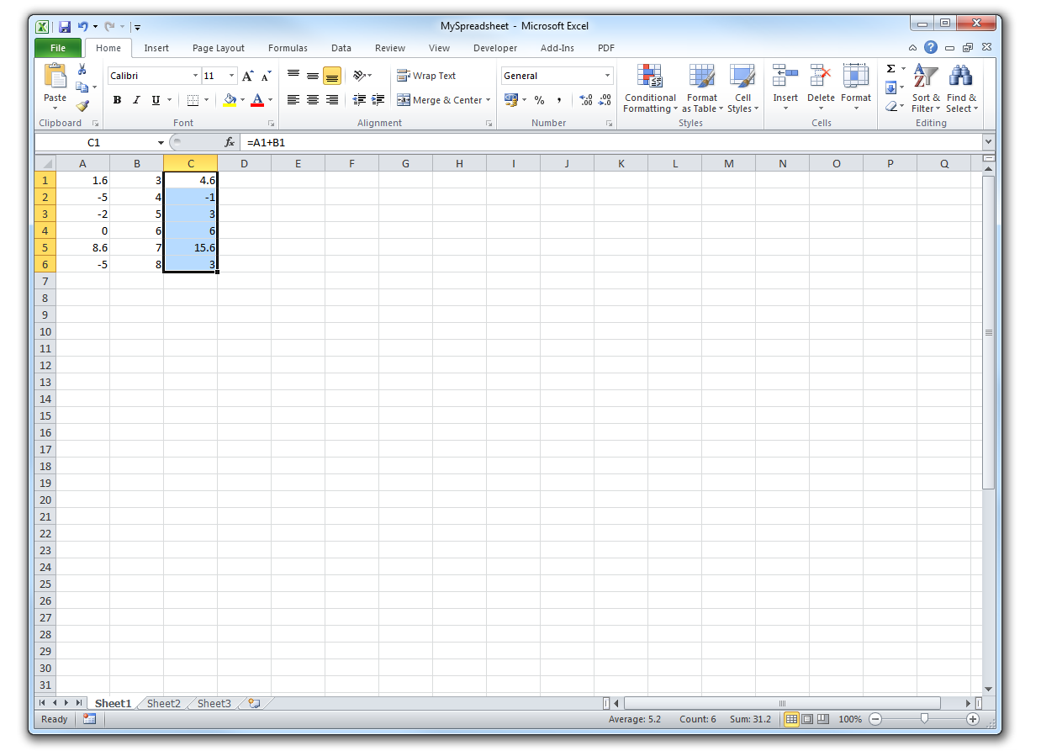
Vector operations

Slide 38
Vector operations
R also knows how to arithmetically combine a vector with a single number
vec1 = c(1.6, -5, -2, 0, 8.6, -5)
vec1+3
vec1-3
vec1*3
vec1/3

Slide 39
A quick note on character vectors
As we'll see later, R can also work with character vectors – i.e. vectors containing strings rather than numbers:
mych = c("exeter", "mathematics", "school")
The indexing notation is still exactly the same:
mych[c(2,3,1,3,2)]

Slide 40
Basic functions
R has hundreds of built-in functions!
To calculate the sum of the whole numbers from 1 to 100, just use the "sum" function:
sum(1:100)
[1] 5050

Slide 41
Basic functions
Quick activity ideas:
How could you have figured out this answer in your head, without using R? (How many different "methods" can you think of?)
Using similar reasoning, can you predict the sum of the whole numbers from 1 to 1000? Use R to check your answer
sum(1:1000)
[1] 500500

Slide 42
Basic functions
A few basic functions to be aware of:
mynum = c(1.6, -5, -2, 0, 8.6, -5)
length(mynum)
mean(mynum)
var(mynum)
sd(mynum)
min(mynum)
max(mynum)
range(mynum)

Slide 43
Basic functions
Some more basic functions to be aware of:
mynum = c(1.6, -5, -2, 0, 8.6, -5)
summary(mynum)
quantile(mynum)
unique(mynum)
rev(mynum)
sort(mynum)
sort(mynum, decreasing=TRUE)
order(mynum)

Slide 44
Basic functions
Note that functions in R always require you to use round brackets
Elements in a vector are always selected using square brackets
An example to illustrate:
sort(mynum[1:3])

Slide 45
Basic functions – which
The "which" function is illustrated below:
which(mynum == -5)
[1] 2 6
which(mynum > 1)
[1] 1 5
Caution: Don't put the < symbol immediately before a minus sign, as <- means "assign" in R

Slide 46
Basic functions – which
It's common for the output from "which" to be used inside square brackets to filter down the data, based on a particular condition:
mynum[which(mynum>1)]
[1] 1.6 8.6
mean(mynum[which(mynum>1)])
[1] 5.1

Slide 47
Basic functions – table
The table function can be particularly useful:
val = c(9, 7, 3, 7, 8, 3, 2)
table(val)
val
2 3 7 8 9
1 2 2 1 1
as.numeric(table(val))
[1] 1 2 2 1 1

Slide 48
Basic functions – table
The table function can be particularly useful:
val = c(9, 7, 3, 7, 8, 3, 2)
table(val)
val
2 3 7 8 9
1 2 2 1 1
names(table(val))
[1] "2" "3" "7" "8" "9"
as.numeric(names(table(val)))
[1] 2 3 7 8 9

Slide 49
Basic functions – head/tail
For long vectors, the functions "head" and "tail" are useful – these just show the start and end of the object (defaults to six values):
bigvec = 1001:10000
head(bigvec)
[1] 1001 1002 1003 1004 1005 1006
tail(bigvec, 4)
[1] 9997 9998 9999 10000

Slide 50
Basic functions – rep
The "rep" function can be used to repeat values – for instance:
rep(9, 10)
[1] 9 9 9 9 9 9 9 9 9 9
rep(3:6, each=4)
[1] 3 3 3 3 4 4 4 4 5 5 5 5 6 6 6 6
rep(3:6, c(2,6,3,5))
[1] 3 3 4 4 4 4 4 4 5 5 5 6 6 6 6 6

Slide 51
Basic functions – seq
Enter the following command in R:
seq(7,30,4)
What do you think the "seq" command does?

Slide 52
Basic functions – seq
Quick activity idea involving sequences:
If a sequence starts with 169 and goes up by 987 each time, will it ever hit a power of ten?
What if the sequence starts with 169 and goes up by 985 each time?
First part: yes – try small powers of ten:
tail(seq(169,1e6,987),3)
[1] 998026 999013 1000000
Extension question: will it hit another?

Slide 53
Basic functions – seq
Quick activity idea involving sequences:
If a sequence starts with 169 and goes up by 987 each time, will it ever hit a power of ten?
What if the sequence starts with 169 and goes up by 985 each time?
Second part: no – final digit is always 9 or 4, so never a power of ten (%% in R is "modulo")
myseq = seq(169,1e6,985)
myseq %% 10

Slide 54
Functions for character vectors
It's worth noting that R also has a number of functions specifically for character vectors (we'll look at these in an activity later):
mych = c("exeter", "mathematics", "school")
nchar(mych)
substr(mych, 1, 3)
grep("h",mych)
gsub("e","E",mych)

Slide 55
Flow commands: for, if/else, while
The following code prints the message "Hello!" on the screen ten times:
for (jj in 1:10) {
print("Hello!")
}
This is an example of a "for loop". The block of code inside the braces is run ten times, with jj taking on each value from 1 to 10 in turn

Slide 56
Flow commands: for, if/else, while
Let's change the code slightly to display the value of jj each time around:
for (jj in 1:10) {
print(jj)
}

Slide 57
Flow commands: for, if/else, while
We could also use the "cat" command to print a message containing the output:
for (jj in 1:10) {
cat("Value of jj is", jj, "\n")
}
The "\n" here simply indicates "new line"

Slide 58
Flow commands: for, if/else, while
Let's now modify the code further to illustrate an "if" condition:
for (jj in 1:10) {
if (jj>=7) {
cat("Value of jj is", jj, "\n")
}
}

Slide 59
Flow commands: for, if/else, while
And here's an example of an if/else condition (note the position of the braces):
for (jj in 1:10) {
if (jj>=7) {
cat("Value of jj is", jj, "\n")
} else {
cat("jj is less than 7\n")
}
}

Slide 60
Flow commands: for, if/else, while
Of course, we could also use the value of jj in other ways – can you figure out the final value of "cursum" when the code below is run?
cursum = 0
for (jj in 1:20) {
if (jj>cursum^2) {
cursum = cursum + jj
}
}

Slide 61
Flow commands: for, if/else, while
Finally, here's a simple while loop:
curval = 240
while (curval>1) {
cat("curval is", curval, "\n")
curval = curval/2
cat("new curval is", curval, "\n")
}
The while condition (curval>1) is checked again each time the code in braces completes

Slide 62
Creating and running a script
A series of commands can be stored as a text file with extension .r – known as an R script
For instance, create a new file (in Notepad++) containing just the following command:
print("Hello Exeter!")
Save the file somewhere on disk under the name myscript.r and then source it into R using the "source" function – for instance:
source("C:/scripts/myscript.r")

Slide 63
Creating and running a script
You should see the message "Hello Exeter!" appear on the screen!
Now extend your script by adding the six lines of code introduced a moment ago to illustrate a while loop (the code starting "curval = 240")
Resave your script (as myscript.r) and source it again – does it run as expected?
You can add comments to a script by including the character # before each comment

Slide 64
Some miscellaneous usage tips
Seven quick tips:
Spaces in R commands are ignored
Use arrow keys to revisit/edit previous commands
To get help on a function, type the ? symbol followed by the function – e.g. ?var
To see the objects in memory, type ls()
To remove an object called x, type rm(x)
To view command history, type history(Inf)
Avoid naming variables as: c q t C D I T F

Slide 65
Statistical examples

Slide 66
Dice rolling
The following command selects a random number from the set {1, 2, 3, 4, 5, 6} (in other words, it represents a simulated dice roll):
sample(1:6, 1)
Run the command a few times to see that the output of the command varies

Slide 67
Dice rolling
For rolling two dice, you might think the equivalent command would be
sample(1:6, 2)
but this isn't quite correct! Why not?

Slide 68
Dice rolling
Answer: We need to sample with replacement, otherwise it's impossible to get the same number on both dice
sample(1:6, 2, replace=TRUE)
How could we confirm that this is doing the right thing?

Slide 69
Dice rolling – a quick simulation
Let's roll the pair of dice repeatedly and find the total each time – we'll do 10000 repeats:
n = 10000
scores = rep(NA, n)
for (jj in 1:n) {
roll = sample(1:6, 2, replace=TRUE)
scores[jj] = sum(roll)
}
table(scores)

Slide 70
Dice rolling – creating a barplot
We can use R to generate a simple bar chart to illustrate this:
barplot(table(scores))
With labels and colour:
barplot(table(scores), xlab="Score", ylab="Frequency", col="red")

Slide 71
Dice rolling – an animated version!
n = 10000
scores = rep(NA, n)
for (jj in 1:n) {
roll = sample(1:6, 2, replace=TRUE)
scores[jj] = sum(roll)
if (jj%%50 == 0) {
barplot(table(scores), xlab="Score",
ylab="Frequency", col="red")
Sys.sleep(0.1)
}
}

Slide 72
Dice rolling – creating a histogram
There is also a built-in histogram function, called "hist", though care should be taken with the breaks that are used, as these can significantly affect the appearance of the chart
For instance, compare the following:
hist(scores)
hist(scores, breaks=seq(1.5,12.5,1))

Slide 73
Dice rolling – creating a histogram
Strictly speaking, the y-axis in a histogram should represent frequency density (though if the bar widths are all equal then it makes no real difference to the chart's appearance)
The following command shows the same histogram with density on the y-axis:
hist(scores, breaks=seq(1.5,12.5,1), freq=FALSE)

Slide 74
Dice rolling – using set.seed
To set the random seed in R, use "set.seed":
set.seed(1)
n = 10000
scores = rep(NA, n)
for (jj in 1:n) {
roll = sample(1:6, 2, replace=TRUE)
scores[jj] = sum(roll)
}
table(scores)

Slide 75
Uniform random numbers
The runif command (which stands for "random uniform") can be used to generate random numbers from a uniform distribution
For instance, to generate a single random number between 0 and 1, the command is:
runif(1,0,1)

Slide 76
Uniform random numbers
Using R we can instantly generate a collection of random numbers from the uniform distribution – for instance:
mysample = runif(10000,0,1)
If you take a large enough sample from the U[0,1] distribution, what values do the mean and variance approach? (Hint: The answer in each case is the reciprocal of a whole number)

Slide 77
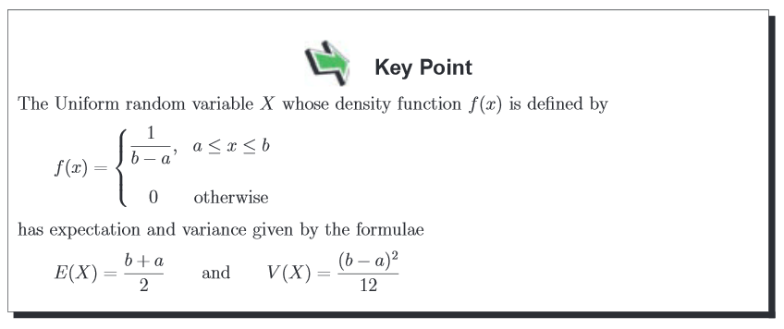
Uniform random numbers
Answer: Mean = 1/2, and variance = 1/12

Slide 78
Uniform random numbers
Once again, we can use the hist function to get a graphical sense of what's going on:
mysample = runif(10000,0,1)
hist(mysample)

Slide 79
Activity idea: Higher or lower?
Suppose we use runif to generate random numbers between 0 and 100 one at a time
After each number is generated, we must guess whether the next number will be higher or lower than the current one
Play the game for a few minutes in R. What do you think is the best strategy?

Slide 80
Activity idea: Higher or lower?
Challenge: Using R, write a piece of code that follows the "optimal" strategy for the game – in other words, it simulates the game and automatically decides on each round whether to go "higher" or "lower"
By simulating the game a large number of times (say 10,000 or 100,000), can you estimate the probability that the game lasts for N rounds (N = 1, 2, 3, …)?

Slide 81
How about other distributions?
R can handle any sort of statistical calculations involving common distributions (including Bernoulli, Binomial, Poisson, Normal, …) including determining percentiles, generating random numbers, and producing plots
Here are a few examples…

Slide 82
Example 1
Plot showing proportion of heads obtained when flipping a fair coin:
nflip = 1000
ht = sample(0:1, nflip, rep=TRUE)
prop = cumsum(ht)/(1:nflip)
plot(1:nflip, prop, ylim=c(0,1), type="l", xlab="Flip number", ylab="Proportion of heads")
abline(h=0.5, col="red")

Slide 83
Example 2
Charts showing Poisson distributions with different means:
barplot(dpois(0:30,3), names.arg=0:30, xlab ="Value", ylab="Density")
barplot(dpois(0:30,15), names.arg=0:30, xlab ="Value", ylab="Density")

Slide 84
Example 3
Normal distribution plots for different means and variances:
xx = seq(-5,5,0.001)
plot(xx,dnorm(xx,0,1),col="red", pch=".", xlab ="Value", ylab="Density")
points(xx,dnorm(xx,0,2), col="blue", pch=".")
points(xx,dnorm(xx,2,1), col="green", pch=".")

Slide 85
Example 4
Histograms of random "height" data generated from a Normal distribution:
set.seed(1)
height10 = rnorm(10,175,8)
height100 = rnorm(100,175,8)
height1000 = rnorm(1000,175,8)
hist(height10, breaks=seq(135,215,1))
hist(height100, breaks=seq(135,215,1))
hist(height1000, breaks=seq(135,215,1))

Slide 86
A note on sample size
For small sample sizes, data points generated from a distribution might be only weakly representative of the shape of the true distribution (such as the 10 draws from a normal distribution shown above)
Using R, it is as easy to work with large data sets as small data sets!
It is also easy to simulate data from scratch to explore statistical ideas

Slide 87
Linear regression with simulated data
First, let's generate some simulated data…
set.seed(42)
x = rnorm(1000, 10, 5)
y = 3*x - 11 + rnorm(1000, 0, 5)
hist(x, breaks=50)
plot(x, y)

Slide 88
Linear regression with simulated data
Fit a line of best fit (a "linear model" in R)
lm1 = lm(y ~ x) # standard linear model
summary(lm1)
# add line to the plot
plot(x, y)
abline(lm1, col="red")
abline(h=0)
abline(v=0)

Slide 89
Linear regression with simulated data
Final example – an 'outlier':
x[17] = 4
y[17] = 60
lm1b = lm(y ~ x)
plot(x, y)
abline(lm1, col="red")
abline(lm1b, col="green")
abline(h=0)
abline(v=0)

Slide 90
A few words on data frames

Slide 91
Data frames
Analogous to a whole sheet in Excel!
The prem data set can be loaded into R using read.csv:
prem = read.csv("C:/RWorkshop/prem.csv", as.is=TRUE)
To see the data's dimensions:
dim(prem)
[1] 3800 7

Slide 92
Data frames
Use the dollar notation (prem$...) to refer to a particular column (each of which is a vector):
sum(prem$hsc)
[1] 5846
To see the column names:
colnames(prem)
[1] "date" "dayno" "seasnum" "ht" "at" "hsc" "asc"

Slide 93
Data frames
New columns can also be defined via the dollar notation:
prem$totsc = prem$hsc + prem$asc
head(prem)
To view particular rows, use square brackets with a comma afterwards – for instance:
prem[1:3,]

Slide 94
Data frames
Data can also be loaded in directly from csv files stored online, such as:
dat = read.csv("http://www.football-data.co.uk/mmz4281/1415/E0.csv")
It's worth noting that there are a variety of data sets packaged with R – for details, type:
library(help = "datasets")

Slide 95
Packaging code as functions

Slide 96
Writing your own functions
We'll start with a simple example – copy/paste the definition below into R:
CalcSquare = function(x) {
y = x^2
return(y)
}
Now test the resulting function:
CalcSquare(7)
[1] 49

Slide 97
Writing your own functions
Of course, you can also call the function and store the answer in a variable:
ans = CalcSquare(9)
ans
[1] 81

Slide 98
Writing your own functions
If we pass a vector into the function, it will be squared:
CalcSquare(7:10)
[1] 49 64 81 100

Slide 99
Writing your own functions
Here's an example for higher powers:
CalcPower = function(x, pow) {
y = x^pow
return(y)
}
CalcPower(7,3)
[1] 343
How would you make pow default to 2?

Slide 100
Writing your own functions
Modified version, including a default for pow:
CalcPower = function(x, pow=2) {
y = x^pow
return(y)
}
CalcPower(7,3)
[1] 343
CalcPower(7)
[1] 49

Slide 101
Writing your own functions
R matches arguments "intelligently":
CalcPower = function(x, pow=2) {
y = x^pow
return(y)
}
CalcPower(po=3, x=7)
[1] 343
CalcPower(p=3, 7)
[1] 343

Slide 102
Writing your own functions
Variables defined inside a function are local to that function!
CalcPower = function(x, pow=2) {
y = x^pow
return(y)
}
y = 11
CalcPower(7,3)
[1] 343
y
[1] 11

Slide 103
Writing your own functions
Pass everything you need into the function – don't rely on variables “outside”, like this!
DodgyCalcPower = function(x) {
y = x^pow
return(y)
}
pow = 3
DodgyCalcPower(7)
[1] 343

Slide 104
Writing your own functions
Finally, a list can be used to return more than one quantity from a function:
SumAndProduct = function(x, y) {
return(list(ss = x+y, pp = x*y))
}
SumAndProduct(1:4, 7:10)
$ss
[1] 8 10 12 14
$pp
[1] 7 16 27 40

Slide 105
Writing your own functions
Finally, a list can be used to return more than one quantity from a function:
SumAndProduct = function(x, y) {
return(list(ss = x+y, pp = x*y))
}
SumAndProduct(1:4, 7:10)
$ss
[1] 8 10 12 14
$pp
[1] 7 16 27 40

Slide 106
Writing your own functions
Final example: lm based on "simulated" data (as considered earlier):
SimLm = function(n=1000, a=3, b=-11, noisesd=5) {
x = rnorm(n, 10, 5)
y = a*x + b + rnorm(n, 0, noisesd)
lm1 = lm(y ~ x)
summary(lm1)
plot(x, y)
abline(lm1, col="red")
abline(h=0)
abline(v=0)
}

Slide 107
Writing your own functions
Some thoughts on code infrastructure
If a collection of functions is available within a script, these functions can all be brought into R with one line of code (using "source")
The user can play with these functions without ever needing to look at the code inside them
Further down the road, it may be useful to include code to check inputs (using commands such as "stop"), but this is not yet a priority

Slide 108
Activity examples

Slide 109
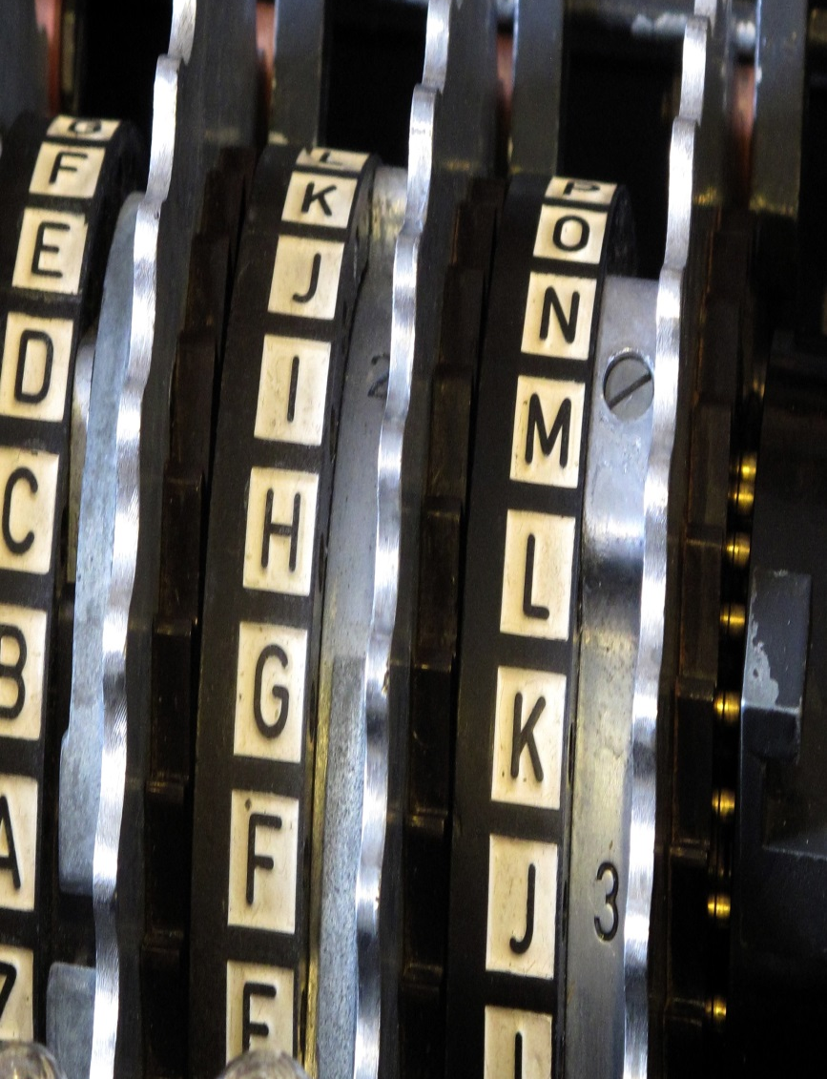
Activity:
Crack the Code!

Slide 110
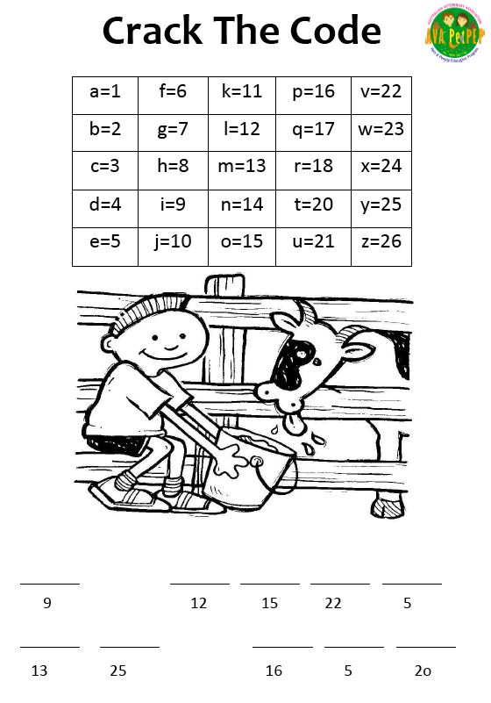

Slide 111
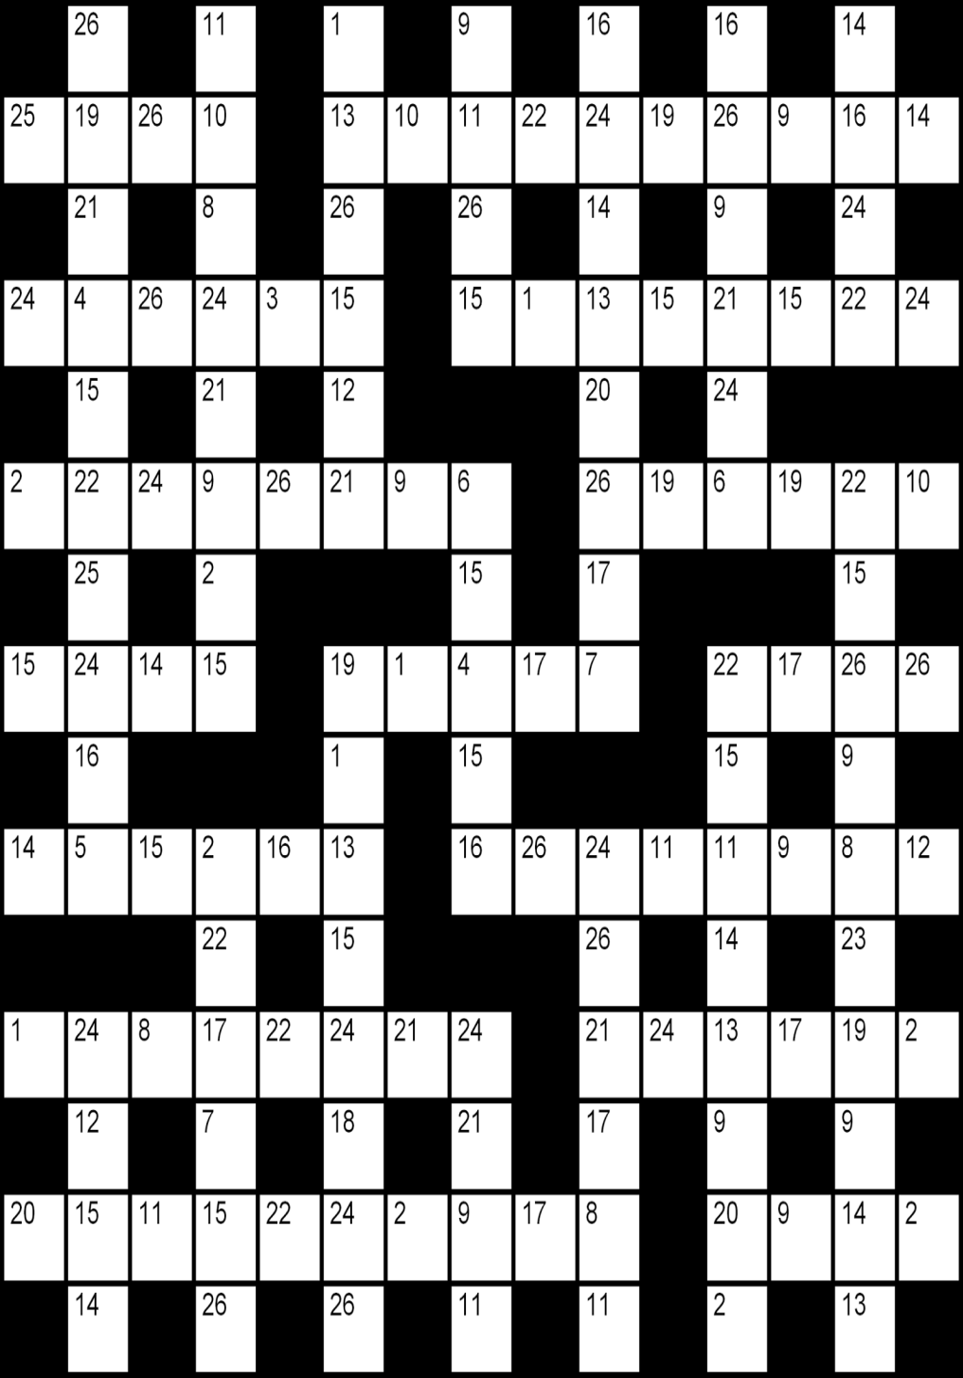

Slide 112
txt = c(" Hello! I'm a short paragraph (containing about ", "50 words) that Tim has written to help illustrate a few ", "text-processing functions in R. As you can see, I'm split ", "over a few lines--five, in fact--with each line consisting ", "of several words. Hope it's all fairly self-explanatory! ") txt = gsub("'", "", txt) txt = gsub("-", " ", txt) txt = tolower(txt) txt = gsub("[^a-z ]", "", txt) txt = gsub("^[ ]+", "", txt) txt = gsub("[ ]+$", "", txt) txt = gsub("[ ]+", " ", txt)
Text cleaning – a simple example

Slide 113
wd = unlist(strsplit(txt," "))
Isolating the words

Slide 114
wd = unlist(strsplit(txt," ")) set.seed(123) shuffle = sample(LETTERS) cc = wd for (i in 1:26) { cc = gsub(letters[i], shuffle[i], cc) }
Shuffling the letters

Slide 115



Slide 116
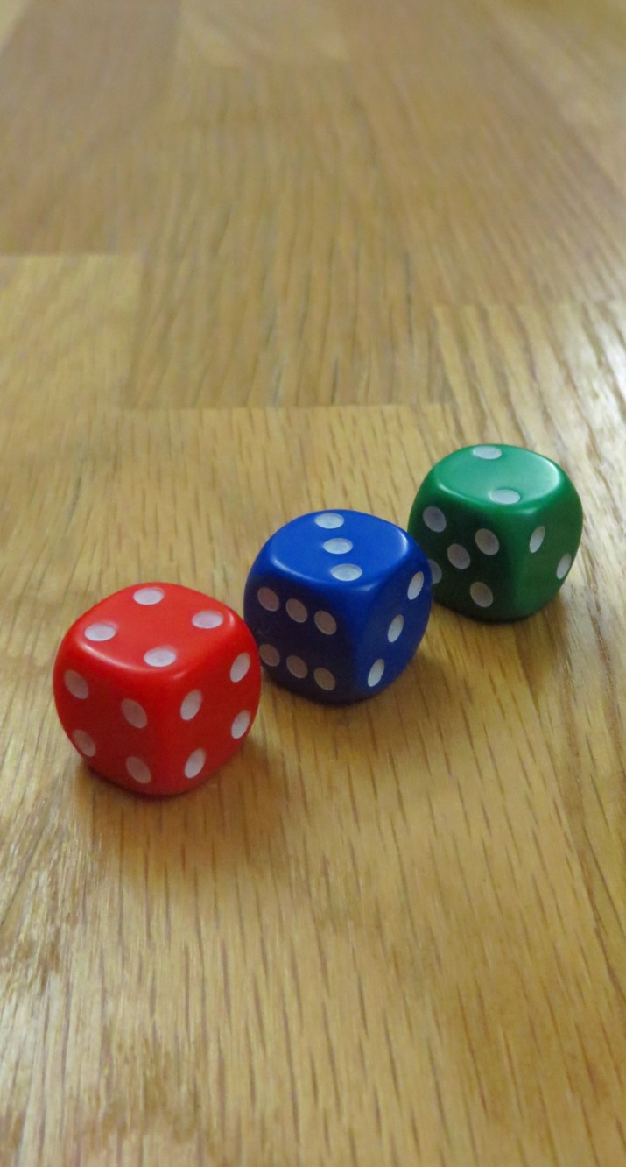
Activity:
Devious
Dice

Slide 117
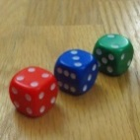
The “Devious Dice” on your tables – coloured Green, Red, and Blue – have unusual patterns of numbers on them… take a look
We’re going to think about which dice is the best for playing “highest roll wins” head-to-head against another dice, and perform a simulation in R to confirm our answer
The task would be really easy if the numbers on the three dice were something like 1,1,1,2,2,2 versus 3,3,3,4,4,4 versus 5,5,5,6,6,6… but for the Devious Dice, it’s less clear which is strongest
Devious Dice

Slide 118
Pupils could spend a while experimenting with rolling these dice (e.g. play "first to win twenty rolls" in pairs) and see what patterns emerge
What is the probability that Red beats Blue on a single roll? What about Blue beating Green on a single roll? Green beating Red on a single roll?
Discuss in your group the simplest / most elegant method to generate these probabilities
Which dice is the strongest?
Devious Dice

Slide 119
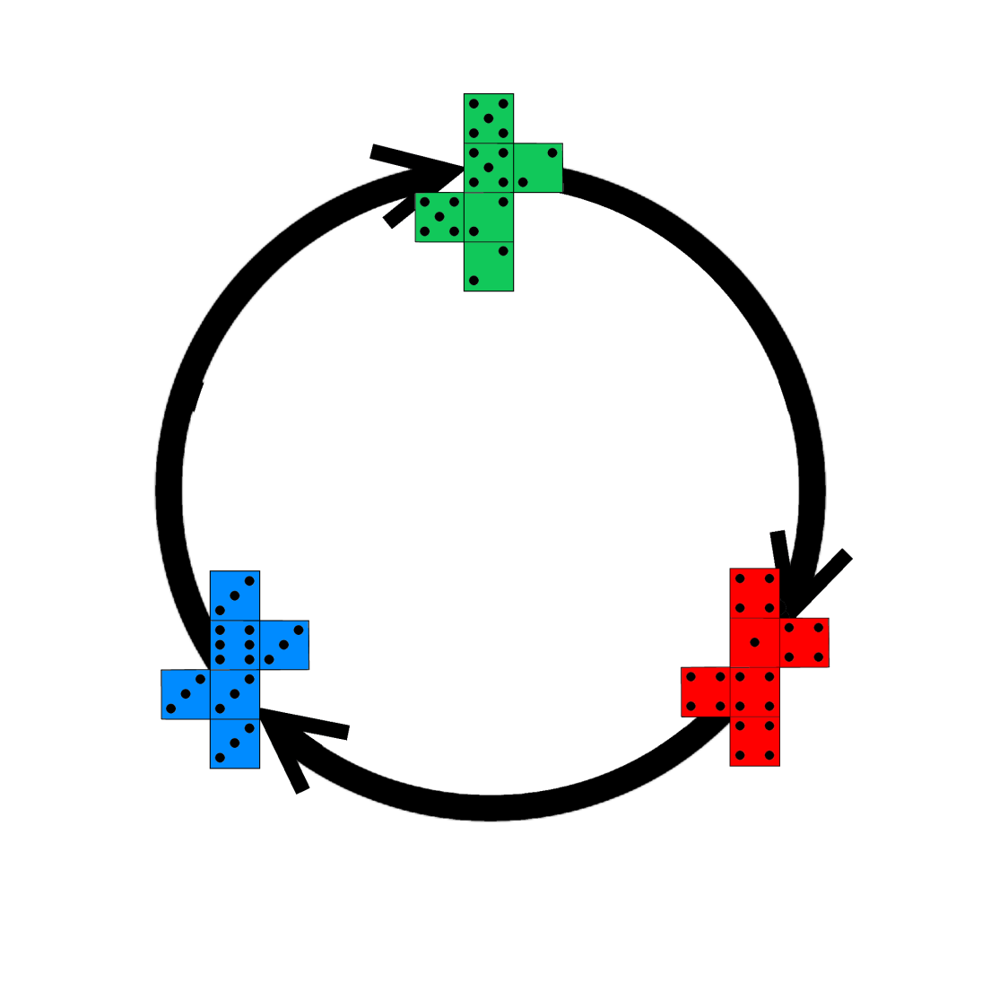
The three dice are designed to be "non-transitive"
7/12 vs 5/12
7/12 vs 5/12
25/36 vs 11/36
Devious Dice

Slide 120
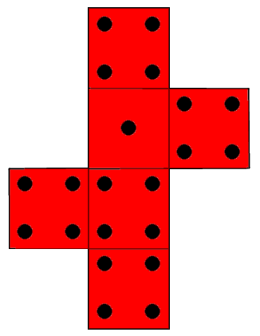
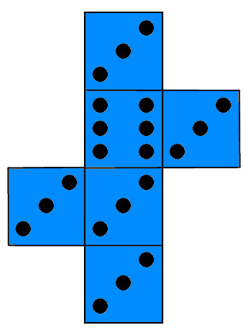
Counterintuitively, there is no best dice! This is tricky to explain, but the key idea is that “size of victory” is irrelevant – all wins count the same
Observe that while each of the dice has 21 dots, when Red fights Blue, all Red's wins are always by just 1 dot (Red 4 vs Blue 3), while Blue's wins are always larger (either 2 or 5 dots)
So Red wins more often, but by a smaller margin
25/36 vs 11/36
Devious Dice

Slide 121
This principle holds for each head-to-head…
7/12 vs 5/12
7/12 vs 5/12
25/36 vs 11/36
Devious Dice

Slide 122
We’ll now illustrate how R can be used to generate these same answers via simulation
Fundamentally, probability can be thought of as a description of what would happen if you were to look at a very large number of repetitions
Probability in the real-world applications almost always involves computer simulations – not working by hand!
Devious Dice

Slide 123
Finding probabilities via computer simulation
set.seed(42)
n = 1000000
red = sample(c(1,4,4,4,4,4), n, replace=TRUE)
blue = sample(c(3,3,3,3,3,6), n, replace=TRUE)
table(red,blue)/n
blue
red 3 6
1 0.138791 0.027883
4 0.693786 0.139540
36*table(red,blue)/n
blue
red 3 6
1 4.996476 1.003788
4 24.976296 5.023440
25/36 vs 11/36
Devious Dice

Slide 124
Finding probabilities via computer simulation
set.seed(42)
n = 1000000
red = sample(c(1,4,4,4,4,4), n, replace=TRUE)
blue = sample(c(3,3,3,3,3,6), n, replace=TRUE)
table(red>blue)
FALSE TRUE
306214 693786
36*table(red>blue)/n
FALSE TRUE
11.0237 24.9763
36*length(which(red>blue))/n
[1] 24.9763
36*length(which(blue>red))/n
[1] 11.0237
25/36 vs 11/36
Devious Dice

Slide 125
Something to ponder over lunch…
If all three dice are rolled at the same time, which one is most likely to win?
Red: 1, 4, 4, 4, 4, 4
Green: 2, 2, 2, 5, 5, 5
Blue: 3, 3, 3, 3, 3, 6
Devious Dice

Slide 126
Finding probabilities via computer simulation
set.seed(42)
n = 1e7
red = sample(c(1,4,4,4,4,4), n, replace=TRUE)
green = sample(c(2,2,2,5,5,5), n, replace=TRUE)
blue = sample(c(3,3,3,3,3,6), n, replace=TRUE)
216*length(which(red>green & red>blue))/n
[1] 74.98816
216*length(which(green>red & green>blue))/n
[1] 90.00545
216*length(which(blue>red & blue>green))/n
[1] 51.00639
75/216 vs 90/216 vs 51/216
Devious Dice

Slide 127
Can we reason these values out directly?
Red: 1, 4, 4, 4, 4, 4
Green: 2, 2, 2, 5, 5, 5
Blue: 3, 3, 3, 3, 3, 6
75/216 vs 90/216 vs 51/216
Devious Dice

Slide 128
The final surprise from the Devious Dice comes when we try rolling two dice of each colour rather than one (e.g. two Red versus two Blue), with each person adding their two rolls together
What would you expect to happen?
(A nice side point to make: a draw still isn't possible when two dice are used – why?)
Devious Dice

Slide 129
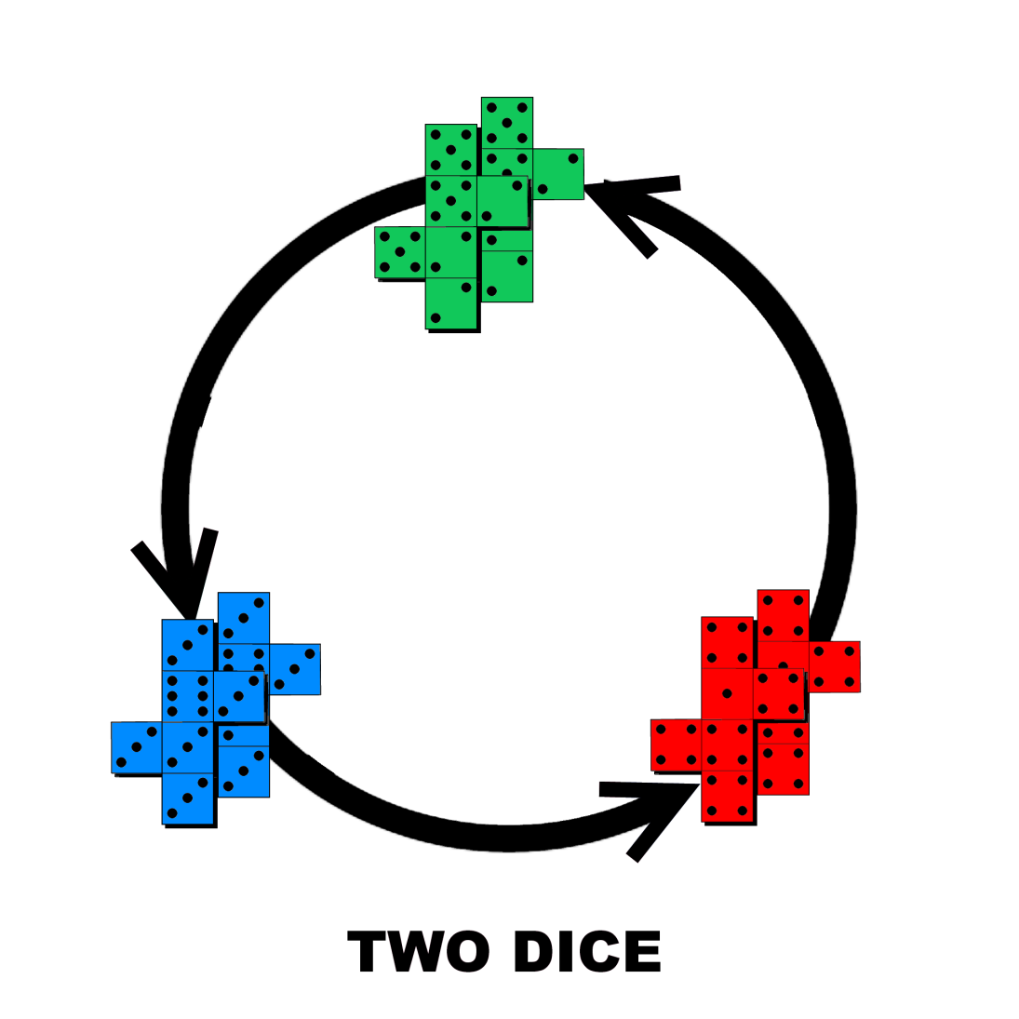
Amazingly, the cycle reverses!
Devious Dice

Slide 130
Over to you…!

Slide 131
Thanks for your attention!
Dr Tim Paulden
tim.paulden@atass-sports.co.uk

